Slide 1
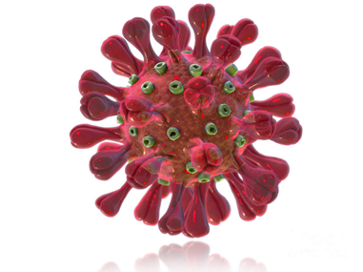
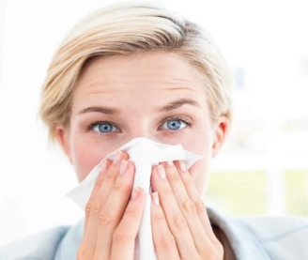

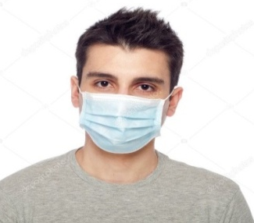
CAUTION - COVID-19!!!
THERE IS NO VACCINE FOR THIS VIRUS!!!
CORONAVIRUS INFECTION is an acute infectious viral disease characterized by inflammation of the respiratory tract, intoxication
Infection occurs:
- through airborne transmission (from a person)
- contact and community-acquired transmission is possible (through common items)
BASIC SYMPTOMS:
- fever
- runny nose
- dry cough
- weakness in the body
- headache
- a sore throat may occur
- diarrhea may occur
TO PROTECT YOURSELF
MAINTAIN PERSONAL HYGIENE:
- wash your hands with soap as often as possible or use antiseptics
- carry out ventilation and daily cleaning of the premises
- avoid touching your face or mucous membranes of the eyes with your hands
PRECAUTIONARY MEASURES:
- avoid close contact with people who have symptoms of respiratory infection
- consume only thermally processed food, bottled or boiled water
- use a face mask for respiratory protection
- refrain from visiting crowded places
- at the first signs of the disease, seek medical assistance
State Insitution "Minsk Сity Center of Hygiene and Epidemiology"

Slide 2
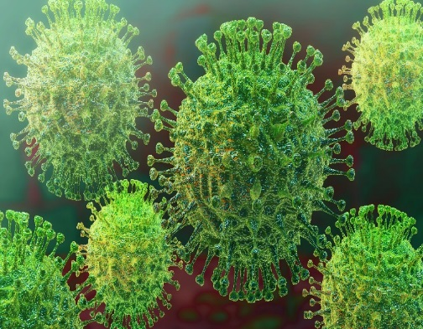
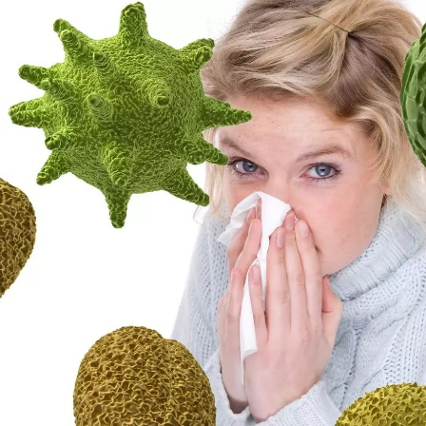

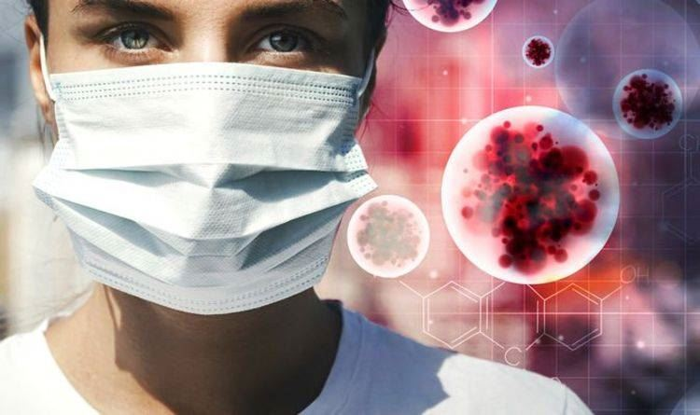
CAUTION - COVID-19!!!
CORONAVIRUS INFECTION is an acute infectious viral disease characterized by inflammation of the respiratory tract, intoxication
INFECTION OCCURS:
- through airborne transmission (from a person)
- contact and community-acquired transmission is possible (through common items)
BASIC SYMPTOMS:
- fever
- runny nose
- dry cough
- weakness in the body
- headache
- a sore throat may occur
- diarrhea may occur
TO PROTECT YOURSELF
MAINTAIN PERSONAL HYGIENE:
- wash your hands with soap as often as possible or use antiseptics
- carry out ventilation and daily cleaning of the premises
- avoid touching your face or mucous membranes of the eyes with your hands
PRECAUTIONARY MEASURES:
- avoid contact with people who have symptoms of respiratory infection
- consume only thermally processed food, bottled or boiled water
- use a face mask for respiratory protection
- refrain from visiting crowded places
- at the first signs of the disease, seek medical assistance
State Insitution «Minsk Сity Center of Hygiene and Epidemiology»

